Slide 1
CS 123B Spring 2017 Midterm 1 Review
4/10/2017

Slide 2
There are bugs in this slide
public void delete(T data) {
if (head == null)
return; // empty
else if (head == tail) {
head = null; // size = 1
tail = null;
}
else if (head.getData() == data)
. . . // delete at head
else
. . . // delete after head
}
“special” cases
“corner” cases
“general” or “vanilla” case
Notes:
1st 2 cases are easy.

Slide 3
Should be …
public void delete(T data) {
if (head == null)
return; // empty
else if (head == tail &&
head.getData().equals(data)) {
head = null; // size = 1
tail = null;
}
else if (head.getData().equals(data))
. . . // delete at head
else
. . . // delete after head
}
“special” cases
“corner” cases
“general” or “vanilla” case
Notes:
1st 2 cases are easy.

Slide 4
Midterm Rules
1 double-sided cheat sheet, 8-1/2 x 11”
Green/Blue book – No other work accepted
Enter upstairs only
Keep your paper face down until told to begin
Exam paper has a partial API
No talking
Write between the lines
Writing after I call time will be treated as cheating

Slide 5
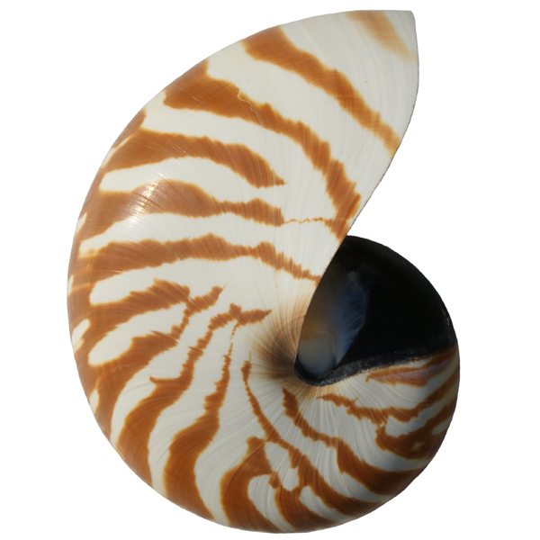
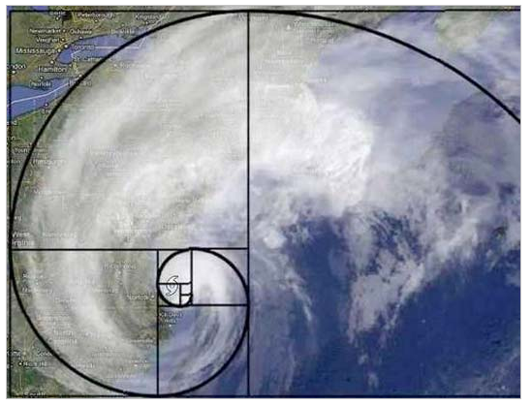


CS 46B: Data Structures Module 5: Midterm 1 & Recursion
Professor Phil Heller

Slide 6
Recursion: When a method calls itself
public void computeKeyToHappiness() {
computeKeyToHappiness();
}
public int computeKeyToHappiness(int n) {
if (n <= 0)
return 42;
return computeKeyToHappiness(n-1);
}
trivial
case
regular
case:
n-1 is
simpler
than n
Notes:
Start here March 14.

Slide 7
When not to use recursion
Recursive methods can be very time-costly
Deceptively few lines of code
Perfect example: Fibonacci numbers
fib(0) = 1
fib(1) = 1
fib(n) = fib(n-2) + fib(n-1)
1, 1, 2, 3, 5, 8, 13, 21, 34, 55, …

Slide 8
Recursion to compute Fibonacci numbers
private int computeFibRecurse(int n)
{
if (n <= 2)
return 1;
else
return computeFibRecurse(n-2) +
computeFibRecurse(n-1);
}
Looks innocent
You’ll see in lab why it’s evil

Slide 9

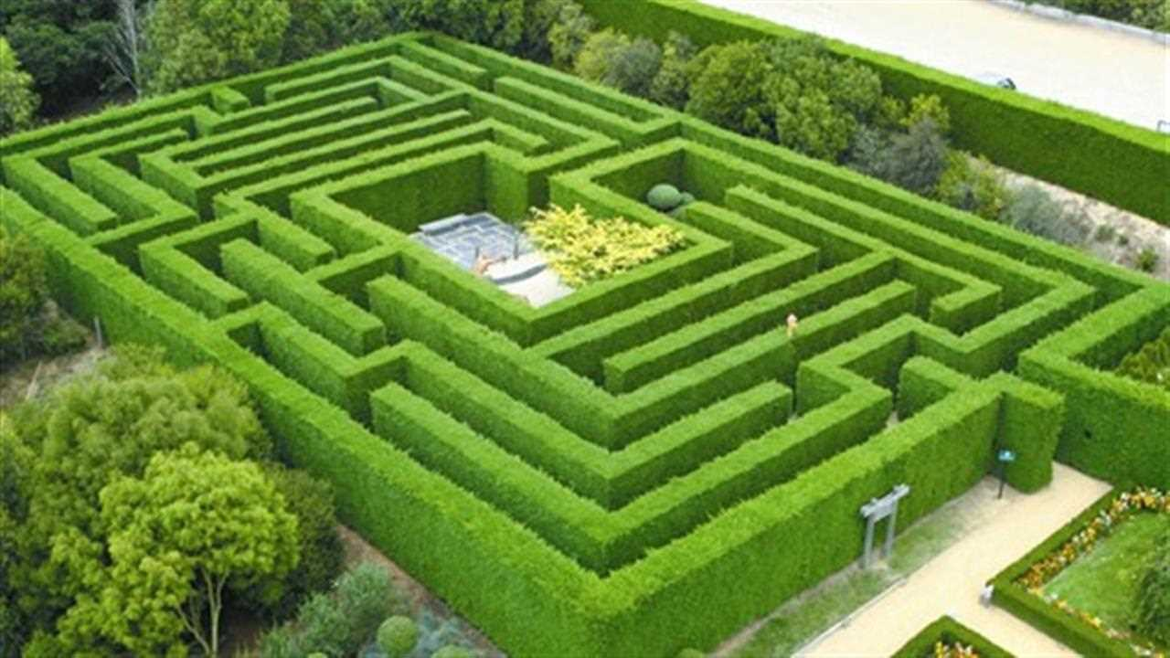

Backtracking: Recursion for finding best solution(s)
Games
Puzzles
Navigation
Cosmology
Conceptis.com

Slide 10
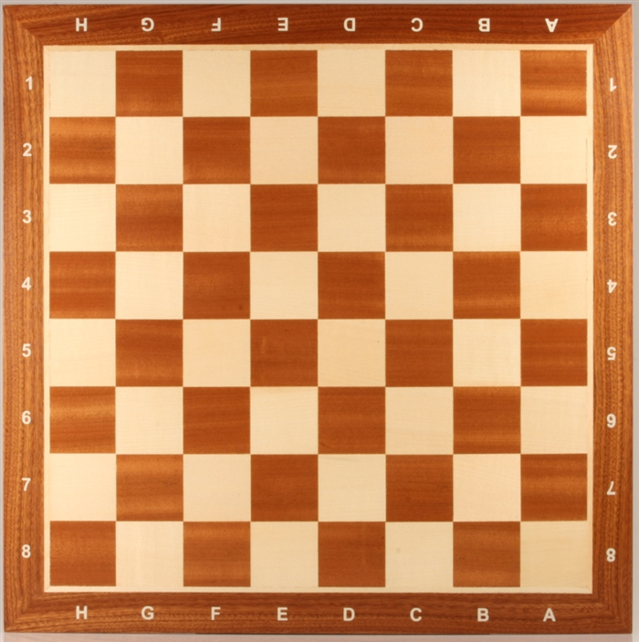
Backtracking example: 8 queens
Place 8 queens on a chess board so that no 2 queens lie in same row, column, or diagonal

Slide 11
Simplified example: 4 queens
Place 4 queens on a chess board so that no 2 queens lie in same row, column, or diagonal

Slide 12
The hard way (“Brute-force solution”)
Compute every possible placement of 4 queens on a 4x4 board.
Evaluate each placement until a legal solution is found
( )
= 16! / 4! * (16-4)!
16
4
= 16! / 4! * 12!
= 1820

Slide 13
The hard way (“Brute-force solution”)
Compute every possible placement of 8 queens on an 8x8 board.
Evaluate each placement until a legal solution is found
( )
= 64! / 8! * (64-8)!
64
8
= 64! / 8! * 56 !
= 3.9 x 10^16
= 39 quadrillion

Slide 14
Backtracking needs to:
Classify boards: 3 possible results
Accept Abandon Continue
Generate all possible next moves from a partial solution
➔
, , …
Notes:
Accept → A complete legal board.
Abandon → An illegal board.
Continue → A legal but incomplete board.

Slide 15
Backtracking: pseudocode
public void solve() {
board ← create empty board
solveRecurse(board)
}
private void solveRecurse(board) {
evaluate board:
ACCEPT → add board to collection of solutions
REJECT → return
CONTINUE →
generate every next move as a list of boards;
for each board b in that list, solveRecurse(b)
}

Slide 16
Backtracking: real code
public HashSet<Board> solve() {
Board emptyBoard = new Board(nCellsPerSide);
solveRecurse(emptyBoard);
return solutions;
}
private void solveRecurse(Board board) {
int eval = board.evaluate();
if (eval == BoardEvaluation.ACCEPT)
solutions.add(board);
else if (eval == BoardEvaluation.ABANDON)
return;
else if (eval == BoardEvaluation.CONTINUE) {
ArrayList<Board> nextBoards =
board.generateAllNextBoards();
for (Board nextBoard: nextBoards)
solveRecurse(nextBoard);
}
}
Notes:
ACCEPT, ABANDON, & CONTINUE look like static constants in class BoardEvaluation

Slide 17
You might implement the constants like this:
class BoardEvaluation {
final static int ACCEPT = 0;
final static int ABANDON = 1;
final static int CONTINUE = 2;
}
Better than using literal 0, 1, & 2
Compiler checks your spelling.
But not great
Any erroneous int will be accepted by the compiler and hence become your problem at run time.
So use an enum instead
A class with a lot of restrictions
Notes:
ACCEPT, ABANDON, & CONTINUE look like static constants in class BoardEvaluation

Slide 18
You might implement the constants like this:
enum BoardEvaluation {
ACCEPT, ABANDON, CONTINUE;
}
Automatic creation of 3 instances of BoardEvaluation. Their names are ACCEPT, ABANDON, and CONTINUE
You refer to them as BoardEvaluation.ACCEPT etc.
Benefit: Compiler finds errors at compile time
Fix at compile time is always better than at run time
Notes:
ACCEPT, ABANDON, & CONTINUE look like static constants in class BoardEvaluation

Slide 19
CS 46B: Data Structures Sorting and Searching
Professor Phil Heller

Slide 20
Sorting Arrays of Numbers
Not done very often in real life
But a great way to think about tasks that are often done in programming projects
Also a simple way to approach analysis of algorithm performance time (“complexity”), which is important 3 ways
Programming excellence
Job interviews
Preparation for CS 146

Slide 21
Sorting Algorithms
The easy / obvious algorithms are slow
Selection Sort: many visits, few moves
Insertion Sort: many moves, few visits
The smart algorithms are fast and recursive
Merge Sort
Quick Sort (in the book, we won’t study it)

Slide 22
Selection Sort
Sorts array members
We’ll look at sorting ints
Could be any numeric primitive type, or any Comparable class type
The big idea: swap array members until the array is sorted
Find smallest member, put it in a[0]
Find next smallest member, put it in a[1]
etc.
Notes:
Start here Wed March 23.

Slide 23
11
5
5
5
9
9
9
9
9
9
17
17
11
11
5
11
12
5
11
17
12
12
12
17
12
17
17
Notes:
11/9/17/5/12 = same example as in the book

Slide 24
public int[] sort() {
for (int startOfUnsorted=0;
startOfUnsorted<a.length; // or a.length-1????
startOfUnsorted++) {
// Find index of smallest member of unsorted region.
int smallestInUnsorted = Integer.MAX_VALUE;
int indexOfSmallest = -1;
for (int i=startOfUnsorted; i<a.length; i++) {
if (a[i] < smallestInUnsorted) {
smallestInUnsorted = a[i];
indexOfSmallest = i;
}
}
// Swap smallest/first members of unsorted region.
a[indexOfSmallest] = a[startOfUnsorted];
a[startOfUnsorted] = smallestInUnsorted ;
}
return a;
}

Slide 25
Selection Sort is O(n^2)
public int[] sort() {
for (int startOfUnsorted=0;
startOfUnsorted<a.length;
startOfUnsorted++) {
. . .
for (int i=startOfUnsorted;
i<a.length;
i++) { . . . }
}
}

Slide 26
Complexity Analysis
What I want to know:
How much time to sort n ints using Selection Sort on my computer?
Why I can’t know that:
Every computer is different: different OS, different Java compiler, different JVM, different load.
Different implementations of algorithms are fast or slow

Slide 27
Complexity Analysis
What I can know:
How will increasing the input size affect execution time?
This mathematical function is called the complexity of the algorithm
Usually expressed as big-O
Complexity is an inherent property of an algorithm, independent of implementation, OS, hardware

Slide 28
Complexity and Big O
# of visits α n²/2 + 2.5n – 3
Drop all terms except fastest-growing: ➔ n²/2
All other terms vanish as n grows
Drop coefficient of fastest-growing term: n²/2 ➔ n²
We say T(n) is “Big O of n-squared”
We write T(n) = O(n²)
What it means:
Measure execution time for some n
Double n ➔ 4x execution time (because 2² = 4)
Triple n ➔ 9x execution time (because 3² = 9)
n x 1000 ➔ 1 million x execution time

Slide 29
For any algorithm:
If we say T(n) = O(n^2), we mean T(n) ~α n^2 for large n
~ means approximately, α means “proportional to”
Much more on this in 146
Other common big-Ohs:
O(n * log(n)) … good sorting
O(n ^ 3) … machine learning
O(n ^ 2) … genetic identification, bad sorting

Slide 30
Big-Oh practice
Drop everything except the fastest growing term, then drop that term’s coefficient
12n³ + 1000n² + 65
➔ O(n³)

Slide 31
Big-Oh practice
Drop everything except the fastest growing term, then drop that term’s coefficient
12n³ + n²*log(n) + 65
➔ O(n³)

Slide 32
More on complexity
Important in algorithms that process all data in a data structure (array, ArrayList, HashSet, TreeSet, …)
Look for loops that process each member of the data structure
for (Movie m: theArchive) {
someRoughlyConstantTimeMethod(m);
}

Slide 33
for (Movie m: theArchive) {
someRoughlyConstantTimeMethod(m);
}
Let n = # of movies in the archive
T(n) = some constant * n
Loop = O(n)
for (Movie m: theArchive) {
constantTimeStuff();
someRoughlyConstantTimeMethod(m);
moreConstantTimeStuff();
}
Let n = # of movies in the archive
T(n) = some other constant * n
Loop = O(n)

Slide 34
Actually, ignore the data processing and just look at the loop
for (int i=0; i<n; i++) {
someRoughlyConstantTimeMethod(whatever);
}
T(n) = some constant * n
Loop = O(n)
for (Thing t: anyCollection) {
someRoughlyConstantTimeMethod(whatever);
}
T(n) = some constant * n
Loop = O(n)

Slide 35
Nested loops
for (int i=0; i<n; i++)
for (int j=0; j<m; j++)
someRoughlyConstantTimeMethod(whatever);
Executes n*m times
T = const * n * m
Loop = O(mn)

Slide 36
Nested loops
for (int i=0; i<n; i++)
for (int j=0; j<n; j++)
someRoughlyConstantTimeMethod(whatever);
Executes n*n times
T = const * n * n
Loop = O(n²)

Slide 37
Nested loops
for (int i=0; i<n; i++)
for (int j=0; j<n; j++)
for (int k=0; j<n; j++)
someRoughlyConstantTimeMethod(whatever);
Executes n*n*n times
T = const * n * n * n
Loop = O(n³)

Slide 38
Nested loops
for (int i=1; i<=n; i++)
for (int j=0; j<i; j++)
someRoughlyConstantTimeMethod(whatever);
Executes 1+2+3+…+n times
T = const * (1+2+3+…+n)
= const * n * (n+1)/2
= const * (.5n² + .5n)
= O(n²)

Slide 39
Merge Sort
Not in-place: uses extra memory
“Divide-and-conquer” algorithm
Recursion simplifies by splitting data set in half, rather than reducing its size by 1
5
7
1
9
6
5
2
3

Slide 40
Merge Sort
Split data in half
Sort each half using Merge Sort
Merge the halves
5
7
1
9
6
5
2
3
1
5
7
9
2
3
5
6
1
2
3
5
5
6
7
9

Slide 41
Eventually
Split data in half
Sort each half using Merge Sort
Merge the halves
6
9
9
6
9
6
5
6
5
9

Slide 42
Complexity of Merge Sort
5
7
1
9
6
5
2
3
5
7
1
9
6
5
2
3
Lots of algebra
Eventually we see that
T(n) is O(n* log(n))

Slide 43
How long does it take to sort 180 exam papers?
T(180) α 180 * log 180 = 1,248 visits

Slide 44
Searching a sorted array
Given a sorted array a of ints
What is the index of some int k?
Linear search:
int findK(int k) {
for (int i=0; i<a.length; i++)
if (a[i] == k)
return i;
return -1;
}

Slide 45
Complexity of linear search in a sorted array
If the array doesn’t contain k:
T(n) = n visits, where n = length of the array
If the array does contain k:
Over many executions, k is equally likely to be in any array slot
Half of the time, k is in the lower half of the array, so T(n) < n/2
Half of the time, k is in the upper half of the array, so T(n) > n/2
On average, T(n) = n/2
➔ In both cases, T(n) = O(n)

Slide 46
CS 46B: Data Structures Boxing/Unboxing
Professor Phil Heller

Slide 47
Java has a wrapper class for all 8 primitive types
Primitive type | Wrapper class
byte | Byte
short | Short
int | Integer
long | Long
float | Float
double | Double
boolean | Boolean
char | Character

Slide 48
Boxing: Where a wrapper is expected, a primitive is accepted
int i = 123;
Integer wrapped = i;
Wouldn’t compile in ancient Java
Compiler converts line 2 to
Integer wrapped =
new Integer(i);

Slide 49
Unboxing: Where a primitive is expected, a wrapper is accepted
Integer wrapped =
new Integer(765);
int i = wrapped;
Wouldn’t compile in early Java
Compiler converts line 2 to
int i = wrapped.intValue();

Slide 50
Chars and other primitives aren’t objects
You can only make method calls on objects
You can’t make method calls on primitives
In Eclipse: Compiler error
On MT2 and final: Heavy penalty

Slide 51

CS 46B: Data Structures Collections
Professor Phil Heller

Slide 52
Interfaces review
interface Flier {
void flap();
void glide();
}
class Parrot implements Flier {
public void flap() { . . . }
public void glide() { . . . }
public void speak() { . . . }
public void squawk() { . . . }
}

Slide 53
Interfaces review: class Parrot implements Flier
Stack Heap
Parrot polly = new Parrot();
polly.speak(); polly.squawk();
polly.flap(); polly.glide();
Flier f = polly;
f.flap();
f.glide();
f.speak();
f.squawk();
Compiler error
Notes:
Start here 10/26/16

Slide 54
A compile-time problem
is always better than
a run-time problem
Notes:
Start here 4/3

Slide 55
Map: A set where every member is associated with another object
aryabhata
alSufi
ptolemy
newton
gamow
deGrasse Tyson
Map’s key set
Map’s values
Notes:
Key set can be a hash set or a tree set

Slide 56
Map: Keys are unique, values don’t have to be
aryabhata
alSufi
ptolemy
newton
gamow
deGrasse Tyson
Map’s key set
Map’s values
Notes:
Here after spring break

Slide 57
Using a tree map
Astronomer arybhata, ptolemy, …;
Star bigStar, littleStar, …;
TreeMap<Star, Astronomer> starToDiscoverer
= new TreeMap<Star, Astronomer>();
starToDiscoverer.put(bigStar, aryabhata);
starToDiscoverer.put(littleStar, ptolemy);
. . .
Astronomer a =
starToDiscoverer.get(littleStar);

Slide 58
Using a tree map
TreeMap<String, Integer> warriorToHt
= new TreeMap<>();
warriorToHt.put(“Curry”, 75);
warriorToHt.put(“Thompson”, 79);
warriorToHt.put(“Green”, 80);
warriorToHt.put(“Durant”, 81);
for (String name: warriorToHt.keySet()) {
Integer inches = warriorToHt.get(name);
System.out.println(name + “ is “ +
inches + “ inches tall.”);
}

Slide 59
Tree map traversal order: sorted keys
Curry is 75 inches tall.
Durant is 81 inches tall.
Green is 80 inches tall.
Thompson is 79 inches tall.
Key type must implement Comparable
Compatible with equals() & hashCode()
1st type in param list: TreeMap<String, Integer>
Because inside every TreeMap<K, V> is a TreeSet<K>
If we used a HashMap<String, Integer>, output order would have been arbitrary
Because inside every HashMap<K, V> is a HashSet<K>

Slide 60
java.util.Stack<T>: pushing & popping
L.I.F.O. = Last In, First Out
public T push(T pushMe)
Inserts pushMe into the stack
Returns pushMe, which you’ll rarely need
public T pop()
Returns the most recently pushed object
Removes that object from the stack
public T peek()
Returns the most recently pushed object
Doesn’t change contents of the stack
Notes:
Start here Mon 4/7

Slide 61

The call stack isn’t just for return addresses
1 static void xyzzy() {
2 int a = 10;
3 double d = 1.4;
4 Star hawking = new BlackHole(); }
5 public static void main(String[] a) {
6 xyzzy(); }
Stack Heap
hawking:
d: 1.4
a: 10
6

Slide 62
Sets and maps: Best practice
Sets: you don’t always know which implementation is best for your situation:
Start with HashSet, change your mind → TreeSet, change again → LinkedHashSet
Maps: you still don’t always know which implementation is best for your situation:
Start with HashMap, change your mind → TreeMap, change again → LinkedHashMap

Slide 63
More best practice
The classes that implement the Set interface have 2 kinds of method:
Methods of the interface
Others
The classes that implement the Map interface have 2 kinds of method:
Methods of the interface
Others
The “others” are (almost) never needed
You (almost) never need to know the implementing class, you just need to know the interface

Slide 64
Best Practice
All references to sets are of type Set<T>
The interface, not any implementing class
The implementing class name only appears in the ctor call
Set<StarChart> starAtlas = new TreeSet<>();
Method arg types are interfaces, not implementing classes
Use the same practice for maps
Notes:
Figure out what this means for the next midterm
Don’t ask someone and hope they got it right

Slide 65

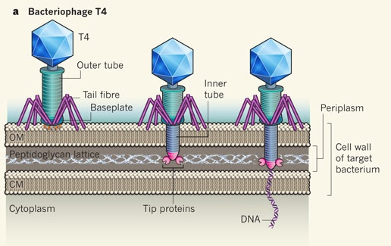
CS 46B: Data Structures Graphs
Professor Phil Heller

Slide 66
CS 46B Definition
Nodes, and edges that join nodes
Nodes are objects
Edges connect nodes
Directed graph: edges are arrows
Node
Node
edge
edge
edge
edge
Node
Node

Slide 67
CS 46B Definition
Nodes, and edges that join nodes
Nodes are objects
Edges connect nodes
Directed graph: edges are arrows
Node
Node
edge
edge
edge
edge
Node
Node
Notes:
Undirected: nodes are floors in the library, edges are stairways. Directed: edges are escalators.

Slide 68


In code
class Organism {
String commonName;
String scientificName;
float lifespan;
float weight;
... (hundreds more)
Set<Organism> preysOn;
}
Organism shark
Organism seal
shark.preysOn.add(seal);
Notes:
The arrow (relationship) is not represented by an object.
Note preysOn type: Set, not an implementing class

Slide 69
That isn’t great O-O design
Organism class does 2 things
Models an organism
Maintains graph structure
Graph programmers don’t care about organisms
Biologists don’t care about graphs
Organism code should be just about organisms
Graph code should just do graph stuff
Detect loops
Analyze complexity
Find interesting structures

Slide 70
Best Practice
class Node<T> {
T data;
Set<Node<T>> neighbors;
Node(T data) { this.data = data; }
void addNeighbor(Node<T> node) { }
void removeNeighbor(Node<T> node) { }
ArrayList<Node<T>> getShortestPathTo(Node<T> n) { }
Set<Node<T>> getNeighbors(int radius) { }
static Set<Set<Node<T>>>
getCliques(Set<Node<T>> graph) { }
}
Node can build graphs of anything
No casting
Notes:
Start here 4/5/17

Slide 71
Now Node is generic, like HashSet
You can do this:
I can do this:
Robot r2d2 = new Robot(); Robot c3po = new Robot();
Node<Robot> robonode = new Node<Robot>(r2d2);
Node<Robot> otherRobonode = new Node<Robot>(c3po);
robonode.addNeighbor(otherRobonode);
Gene mdm = new Gene(); Gene p53 = new Gene();
Node<Gene> mdmNode = new Node<Gene>(mdm);
Node<Gene> p53Node = new Node<Gene>(p53);
mdmNode.addNeighbor (p53Node );

Slide 72
Special Directed Graphs: Linked Lists
Head Tail
1 edge into every node except the head
1 edge from every node except the tail
Notes:
Clicker quiz opportunity

Slide 73
Implementing Linked List
At most 1 edge from any node ➔ Node has at most 1 neighbor
Don’t need a Set<Node> to represent neighbors
class Node {
private Node next;
private Object data;
}
class LinkedList {
private Node head;
private Node tail;
}

Slide 74
With a Linked List
LinkedList
Node
Dot
head
tail
data
next
Node
Dot
data
next
Node
Dot
data
next
Notes:
Start Wed April 12

Slide 75
Simplified
lightDots
darkDots

Slide 76
Simplified
purpleDot.next = lightDots.head;
lightDots
darkDots

Slide 77
Simplified
purpleDot.next = lightDots.head;
lightDots.tail.next = tealDot;
lightDots
darkDots

Slide 78
Simplified
purpleDot.next = lightDots.head;
lightDots.tail.next = tealDot;
T(n) = 2 = O(1)
lightDots
darkDots

Slide 79
lightColors
darkColors
head
tail
data
next
head
tail
data
next
data
next
data
next
data
next
data
next
data
next
Linked List
Node<Dot>
data
next
Dot

Slide 80
public void insertAtHead(T data) {
Node<T> node = new Node<T>(data);
node.next = head;
head = node;
if (tail == null)
tail = node;
}

Slide 81
public void insertAtHead(T data) {
Node<T> node = new Node<T>(data);
node.next = head;
head = node;
if (tail == null)
tail = node;
}
// ???
head
tail

Slide 82
public void insertAtHead(T data) {
Node<T> node = new Node<T>(data);
node.next = head;
head = node;
if (tail == null)
tail = node;
}
//
In case
list is empty
head
tail

Slide 83
public void appendAtTail (T data) {
Node<T> node = new Node<T>(data);
if (tail != null)
tail.next = node; // not empty
else
head = node; // empty
tail = node;
}
head
tail

Slide 84
public void appendAtTail (T data) {
Node<T> node = new Node<T>(data);
if (tail != null)
tail.next = node; // not empty
else
head = node; // empty
tail = node;
}
head
tail

Slide 85
Is this necessary?
public int size() {
if (head == null)
return 0; // empty
int n = 0;
Node<T> node = head;
while (node != null) {
n++;
node = node.next;
}
return n;
}

Slide 86
How to write linked list methods
Draw the picture.
Code for the vanilla case.
On return from your method, does linked list still have integrity?
Think of all possible corner cases.
Code for all corner cases that need special handling.
Test vanilla case.
Test all corner cases, especially empty list.

